Slide 1


CreativeXD
SpiritHack 1.0
Team Members:
Aditya Agarwal
Aneesh Agarwal
Nandini Gupta
Radhika Agrawal

Slide 2


Problem Statement:
During these days when everyone is getting digital and most of the day to day transactions are online, paying traffic fines offline is a very tedious and time consuming process. So design a website where any user can login using their registered vehicle plate number or Aadhar Number and check and pay his fine.

Slide 3
Technologies Used:
HTML
CSS
JAVA SCRIPT
ADOBE XD
VS CODE
GIT HUB

Slide 4
Approach:
Pertaining to the problem statement, we planned out a simple and elegant interface for the end user to be able to identify the user's traffic fines based on a system that detects speed of the vehicle.
This fine can either be contested in court by the guilty party or using this interface they are can pay their dues online during these corona times.
Here in this interface we will basically be considering a database provided by the government which will accept vehicle plate number and Aadhar to log on the id.

Slide 5
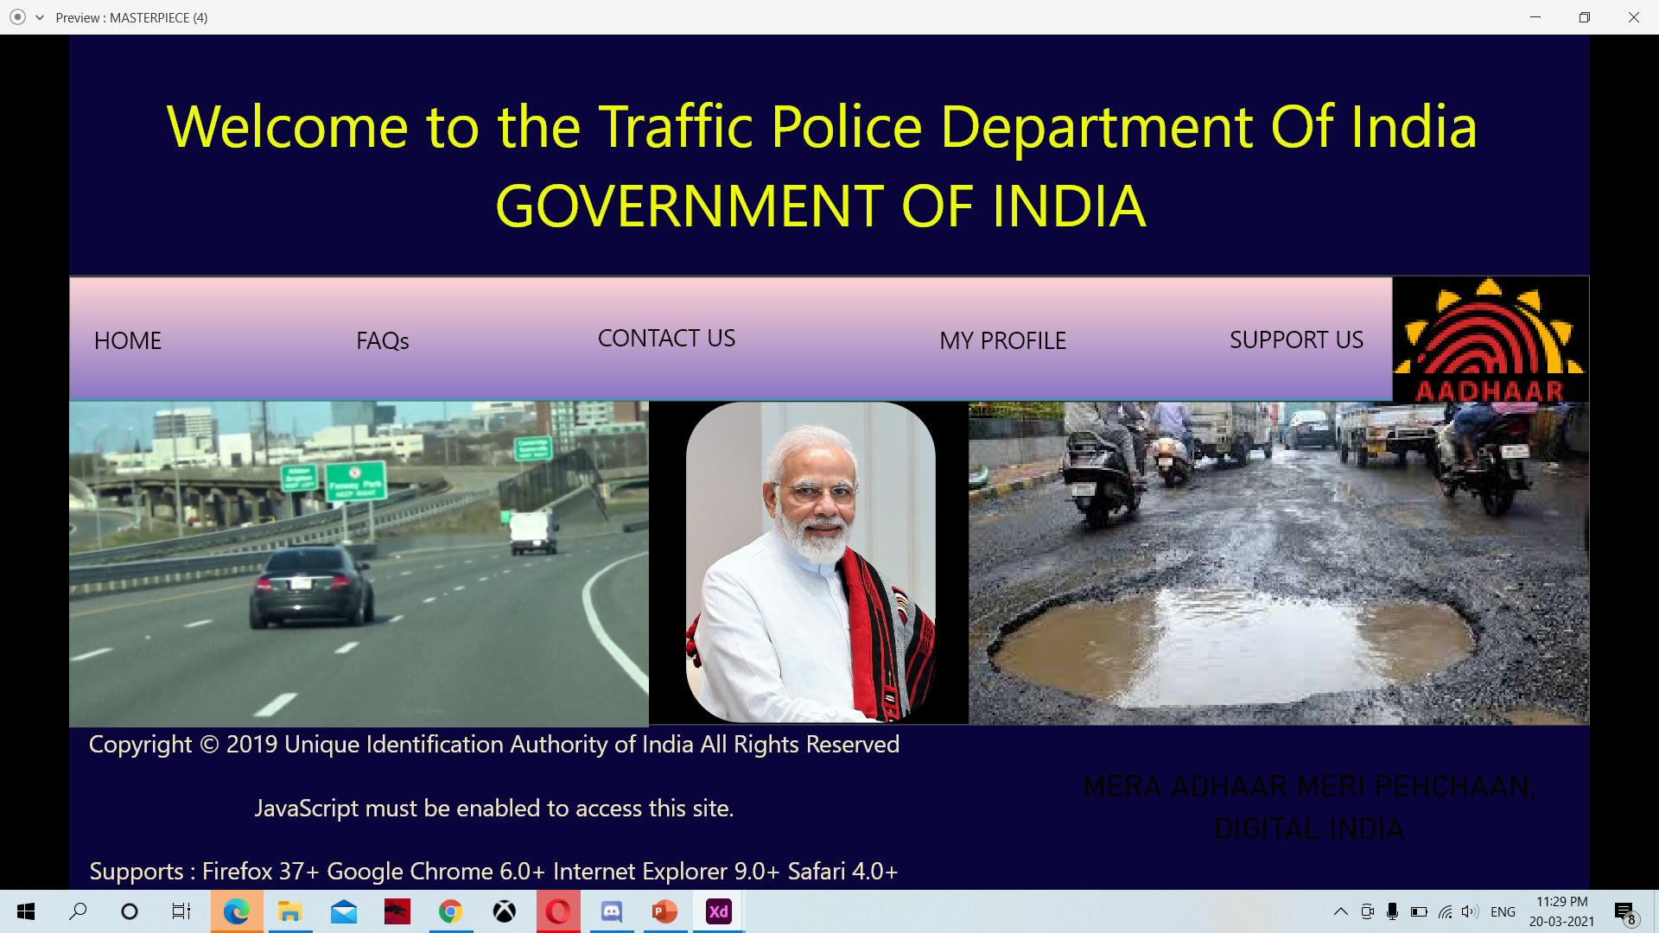
This is the front page:

Slide 6
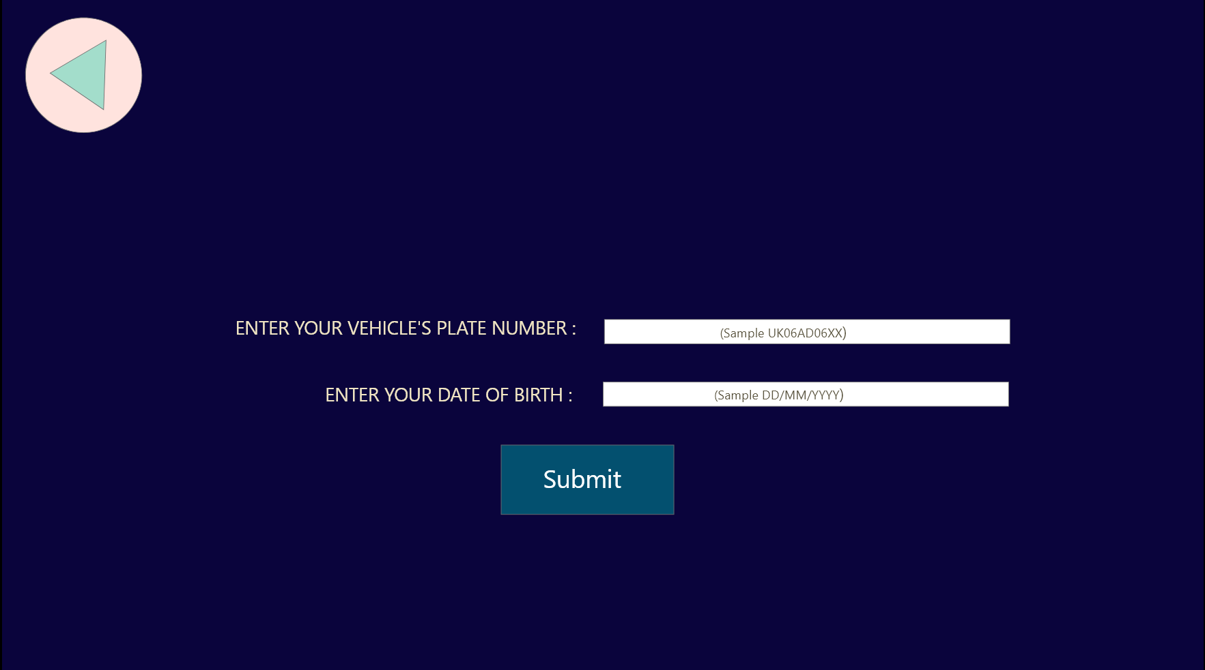
After clicking on “My Profile”, following page will appear:

Slide 7
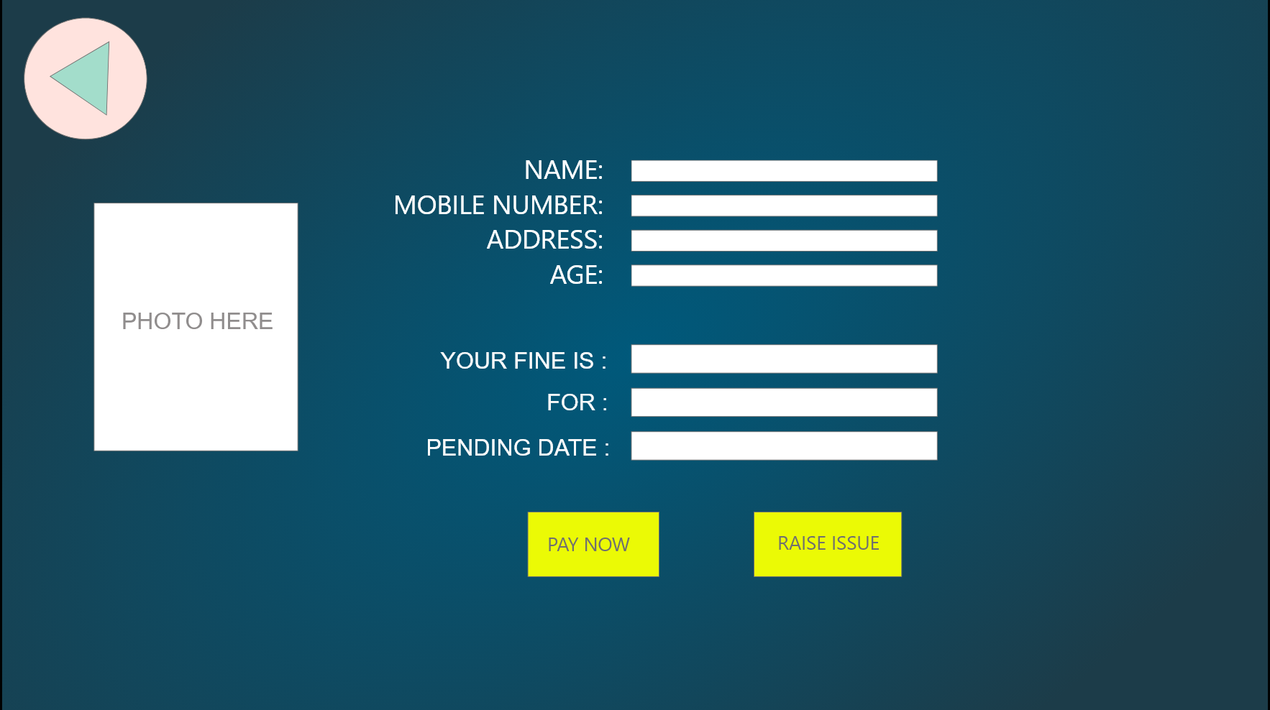
Page where user’s details will be displayed:

Slide 8
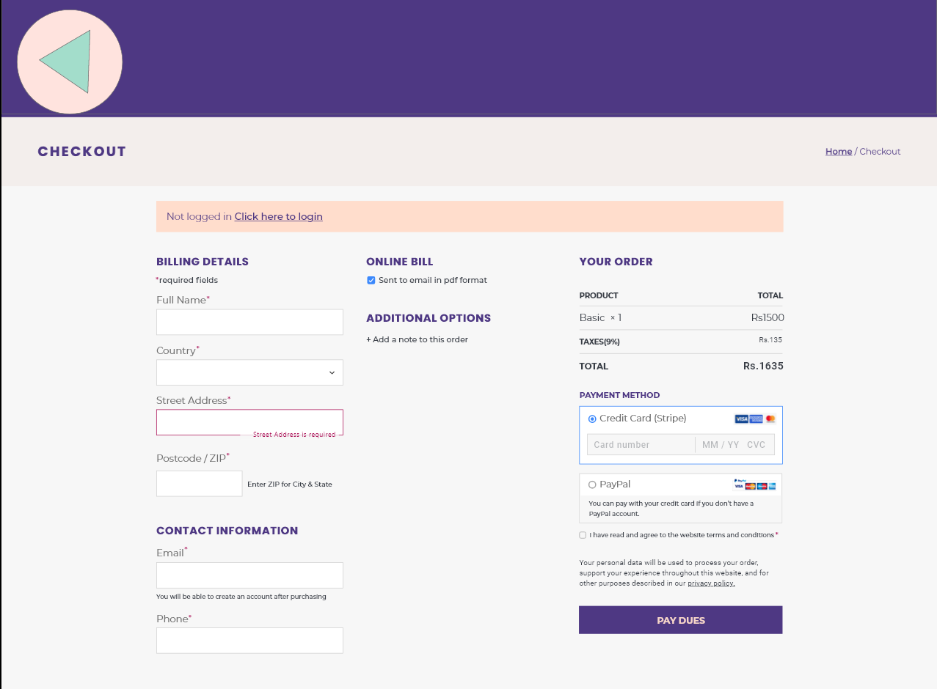
Pay your dues here….

Slide 9
Thank You

